Slide 1
Financial Statement Analysis and Firm Performance
Name
Institution

Slide 2
Executive Summary
Benali Coffee is a startup business that intends to start its operations in the Kingdom of Saudi Arabia. The firm has conducted an in depth market research of the firm and has identified that it has major prospects associated with the community’s taste of superior coffee. Therefore, the company will be importing coffee in The Kingdom and subsequently blending it to the taste of the Saudis. The coffee shop will be located on the outskirts of Riyadh on one of the major highways existing the city. The primary target of the firm is the motorists leaving the city because they are fond of drinking the product while travelling. The industry analysis indicates that most of coffee available in the market is the Arabic coffee and introducing imported coffee will present the firm with a marketing leverage. Major competitors are coffeehouses located in the country that are well-established in the market. Therefore, the firm will apply a product differentiation marketing strategy.

Slide 3
Country Description
Saudi Arabia is the largest market in the Gulf Cooperation Council (GCC) region
The country has the largest economy in the region with a GDP of $683.7 billion
The Kingdom is also the only members of the G20 in the region, highlighting its economic and political prowess in the Arab World
Business potential is underlined by its crude oil sector that accounts for approximately 26 percent of the international petroleum reserves
However, the government controls most of the economic activities in the market
Nonetheless, the government has embarked on a stringent economic and social changes that are directed towards enhancing the economic growth under the country’s Vision 2030
Other barriers that may negatively affect foreign companies to make successful entry into the market include terrorist threats, gender discrimination, and overdependence on petroleum as the main contributor to the national GDP (Al-Janadi, Abdul Rahman, & Alazzani, 2016)

Slide 4
Business Description
Benali is a startup company that will specialize in the provision of coffee beverages
The firm has identified the need to invest in the country primarily because of the dynamic market
Coffee is one of the most popular beverages in the region and therefore the firm anticipates to have a positive response in the market
The company will be importing coffee from major coffee producers in the world including Brazil and Guatemala
The company will capitalize on the production of different coffee blends that are not popular in the country although it will engage in a rigorous marketing campaign to appeal to the target population
The firm will also focus on differentiating its beverages primarily because most of the coffee consumed in the market is the Arabian coffee

Slide 5
Company Structure
The firm legal structure is a limited liability company with two directors
The directors will oversee the operations of the firm
In addition, the company will also include various departments as highlighted below
  Marketing headed by a marketing manager and staffed by salespersons
  Finance department headed by the financial officer and staffed by the accountant and auditors
  Operations department staffed by operations managers, product developers, and other support staff
The firm’s decision to use the limited liability company is the diminished responsibilities associated with various risks that exempts the owners from such factors as personal income taxes

Slide 6
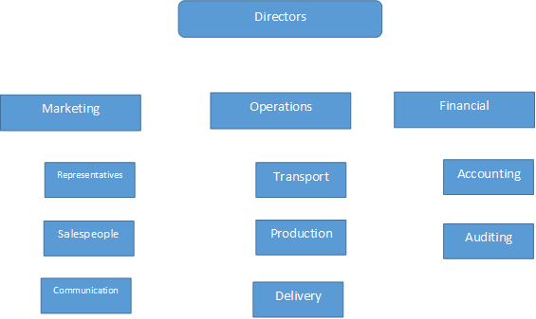
Organizational Structure

Slide 7
Market Analysis
Saudi Arabia is one of the leading consumers of coffee in the world
The country’s consumption of coffee is highlighted by various statistics as demonstrated below:
  Coffee sales in the country rose by 77% in the year 2016 surpassing other popular beverages as tea
  The coffee market rose by $4 billion in 2014 making the country one of the leading consumers of the commodity in the market
  18,000 tons of coffee worth $54 million are imported in the country
The economic performance of the country indicates that most people can afford upmarket coffee beverages because of indicators such as per capital income and households income
The market is also ready to try some of the coffee blends that have not been introduced in the market

Slide 8
Industry Analysis
The coffee industry in the international market has recorded significant growth
1.4 billion cups of coffee are consumed daily internationally
Youth are the most target demographical groups in the market because they have been influenced by various media that highlight coffee as commodity associated with popular culture
International production of coffee has gained momentum due to the increased marketing opportunities in the world particular in Arab and Western countries
However, there is stiff competition in the industry associated with proliferation of coffee shops, provision of drive-through sales, and increased varieties of coffee products
Nevertheless, the industry is challenged with the health concerns associated with overconsumption of caffeine-based beverages such as coffee, tea, and cocoa (Claar & Haight, 2015)

Slide 9
Competition Analysis
Benali anticipates competition from a variety of businesses, processors, and beverages
There is a proliferation of coffee cafes in the market that may present aggressive competition in the market
Additionally, tea is still a very popular beverage and has been a traditional favorite for most countries in the region for many centuries
Government opening up its market to foreign companies means that there will be many providers in the market, which will result with many foreigners entering the market
Well-established restaurants will be influential competitors because they have acquired the required market share and significant percentage of loyal customers within the target population (Al-Abdulkader, Al-Namazi, Alturki, Al-Khuraish, & Al-Dakhil, 2018)

Slide 10
Marketing Plan
Benali intends to attract motorists as its primary target population
Nevertheless, the firm will also ensure that it provides high quality products that will attract other demographics such as people from the city who may visit the coffee shop because of its high quality beverages
The firm’s marketing strategy will be primarily product differentiation, which will be complemented by other marketing strategies such as pricing
Product differential is preferable because it will ensure that Benali will attract a market segment that will cultivate loyalty, which will be influential in future marketing endeavors
In addition, the marketing plan will use the latest strategies because Saudi Arabia has incorporate some of the latest technologies such as internet and social media to communicate with the target market

Slide 11
Sales Plan
The firm has a number of strategies to enhance its ability of creating revenue for its sustainability and profitability
One of the strategies is communicating and engaging the customer on various platforms
The primary target being motorists means that most of them use the radio and smartphones when travelling
Therefore, radio adverts and social media messages will be influential in ensuring that the organization can engage the customers efficiently
In addition, the firm will also hire an effective marketing team that will be responsible of spreading the news about the existence of its products

Slide 12
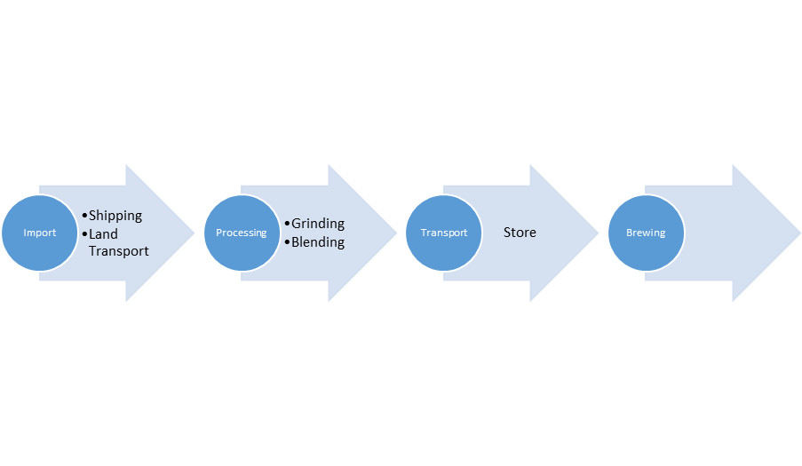
Operational Plan
Benali will be outsourcing its coffee from major coffee producers in the world
The firm will be processing the coffee in its established plant in Saudi Arabia and the different blends will be transported to its store in one of the major highways of the city
The brewer will blend the coffee in the stores in different flavors

Slide 13
Budget
Activity | Cost($)
Premises | 40,000
Wages | 35,000
Equipment | 45,000
Store Furniture | 40,000
Marketing | 30,000
Inventory | 50,000
Transport | 60,000
Total | 300,000
The firm will invest $300,000 as the startup capital
The primary cost drivers during the startup will include
  Premises
  Wages
  Equipment
  Store furniture
  Marketing
  Inventory
  Transport

Slide 14
Three Year Financial Statements (Income Statement)
Income Statements
 | Year 1 | Year 2 | Year 3
Revenues | 250,000 | 300,000 | 350,000
Expenses
Cost of goods sold | 30,000 | 30,000 | 30,000
Commissions expense | 12,500 | 15,000 | 17,500
Supply expense | 50,000 | 50,000 | 50,000
Equipment | 45,000 | 45,000 | 45,000
Marketing | 30,000 | 30,000 | 30,000
Interest | 37,500 | 45,000 | 52,500
Total Expenses | 205,000 | 215,000 | 225,000
Net Income | 45,000 | 85,000 | 125,000

Slide 15
Cash Flows
Cash Flow Statement
 | Year 1 | Year 2 | Year 3
Operating Cash Flow | $ 45,000.00 | $ 85,000.00 | $ 125,000.00
Investment Cash Flow | $ (10,000.00) | $ 10,000.00 | $ 10,000.00
Financing Cash Flow
Repayment of debt | $ - | $ 20,000.00 | $ 20,000.00
Issuance (Equity) | $ - | $ - | $ -
Cash From Financing | $ - | $ 20,000.00 | $ 20,000.00
Closing Balance | $ 35,000.00 | $ 75,000.00 | $ 115,000.00

Slide 16
Business Health Assessment
The cash flows indicate that the firm will be capable of meeting its obligations within the first year and reach a breakeven analysis within the second year
However, for the company to achieve the projected financial results, it is important for the organization to ensure that it is committed to aggressive marketing in the market
In addition, the firm will need to ensure that it can successfully utilize its assets in revenue generation to enhance its ability of remaining liquid in case it needs to quickly offset some of its obligations
The firm will need to invest in other assets such as property and equipment to ascertain that it can meet its long-term obligations

Slide 17
Conclusion
Benali Coffee has the potential of making a positive entry into the Saudi market
However, there are a number of factors that may limit the organization from achieving its objectives including government involvement in the business activities of the country
On the other hand, the market is very promising based on the fact that coffee has increased its consumption in the country significantly over the last few years
Nonetheless, the firm will need to ensure that it is capable of achieving its financial goals through the incorporation of marketing and management strategies influential in improving its performance in the market

Slide 18
References
Al-Abdulkader, A. M., Al-Namazi, A. A., AlTurki, T. A., Al-Khuraish, M. M., & Al-Dakhil, A. I. (2018). Optimizing coffee cultivation and its impact on economic growth and export earnings of the producing countries: The case of Saudi Arabia. Saudi journal of biological sciences, 25(4), 776-782.
Al-Janadi, Y., Abdul Rahman, R., & Alazzani, A. (2016). Does government ownership affect corporate governance and corporate disclosure? Evidence from Saudi Arabia. Managerial Auditing Journal, 31(8/9), 871-890.
Claar, V. V., & Haight, C. E. (2015). Correspondence: Fair Trade Coffee. Journal of Economic Perspectives, 29(1), 215-16.

